Slide 1
C Programming Introduction - Basics of C programming
Week 1

Slide 2
Contents
Introduction to C
Compilation of C programs
Syntax
Data types
Functions
Program execution
I/O standard and File

Slide 3
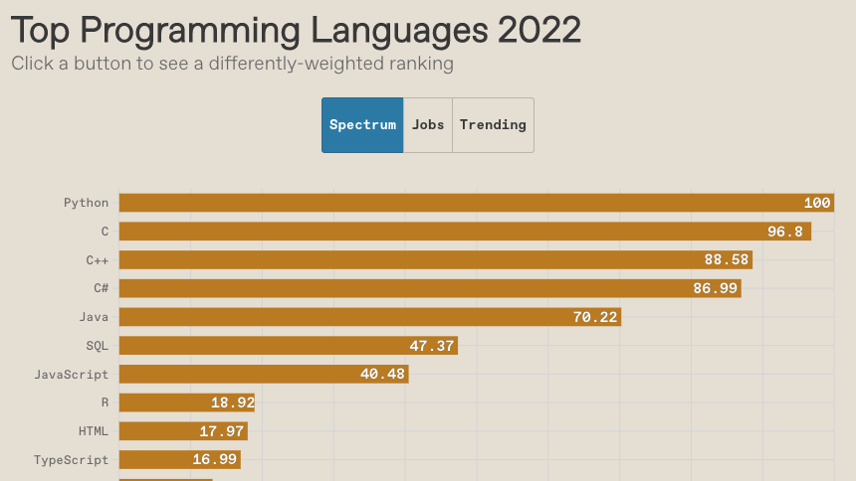

IEEE Spectrum
2022-08-23
Job listings are of course not the only metrics we look at in Spectrum. A complete list of our sources is here, but in a nutshell we look at nine metrics that we think are good proxies for measuring what languages people are programming in. Sources include GitHub, Google, Stack Overflow, Twitter, and IEEE Xplore. The raw data is normalized and weighted according to the different rankings offered—for example, the Spectrum default ranking is heavily weighted toward the interests of IEEE members,

Slide 4
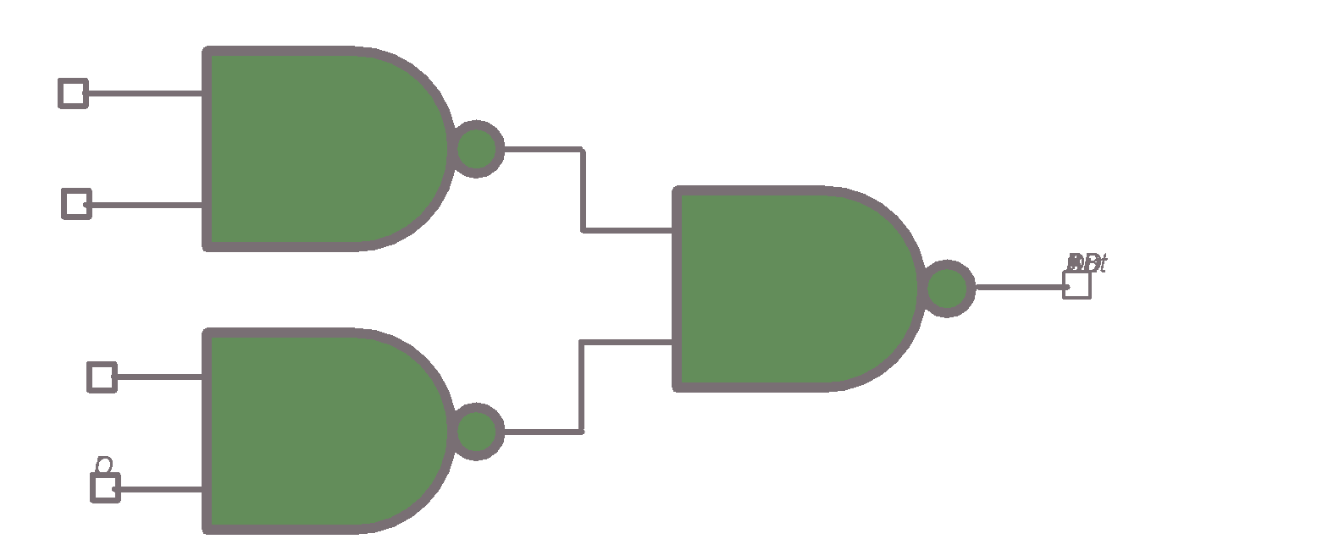
Great Idea #1: Abstraction (Levels of Representation/Interpretation)
High Level Language Program (e.g., C)
temp = v[k];
v[k] = v[k+1];
v[k+1] = temp;
Compiler
lw x3, 0(x10)
lw x4, 4(x10)
sw x4, 0(x10)
sw x3, 4(x10)
Assembly Language Program (e.g., RISC-V)
Anything can be represented as bits, i.e., data or instructions
Assembler
1000 1101 1110 0010 0000 0000 0000 0000
1000 1110 0001 0000 0000 0000 0000 0100
1010 1110 0001 0010 0000 0000 0000 0000
1010 1101 1110 0010 0000 0000 0000 0100
Machine Language Program (RISC-V)
Hardware Architecture Description (e.g., block diagrams)
+4
Reg
[]
pc
pc+4
1
wb
DataD
Reg
[rs1]
1
ALU
alu
2
alu
0
pc
IMEM
inst
[11:7]
AddrD
Reg
[rs2]
0
Addr
DMEM
1
wb
pc+4
inst
[19:15]
AddrA
DataA
Branch
0
DataW
DataR
mem
0
Architecture Implementation
inst
[24:20]
AddrB
DataB
Comp.
1
Logic Circuit Description (Circuit Schematic Diagrams)
inst
[31:7]
Imm
.
imm
[31:0]
Gen

Slide 5
Introduction to C
Why C?
We can write programs that allow us to exploit underlying features of the architecture
memory management, special instructions, parallelism
C and derivatives (C++/Obj-C/C#) still one of the most popular programming languages after >40 years!
Both high level and low-level language

Slide 6
Compile
vs
Interpret

Slide 7
Compilation: Overview
C compilers map C programs directly into architecture-specific machine code (string of 1s and 0s)
For C, generally a two parts process of compiling .c files to .o files, then linking the .o files into executables;
Assembling is also done (but is hidden, i.e., done automatically, by default)

Slide 8
Getting started
#include <stdio.h> int main() {
printf("Hello World!\n");
}

Slide 9


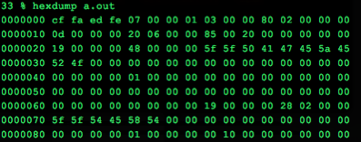
Compilation
#include <stdio.h>
#define HELLO "Hello World!\n" int main() {
printf(HELLO);
}
Start with a human readable file containing your source program and possibly some references to libraries
Call the C compiler to obtain an executable file, which is a sequence of numbers that can run on the target hardware
gcc -std=c99 -c hello.c
gcc -o a.out hello.o
./a.out

Slide 10
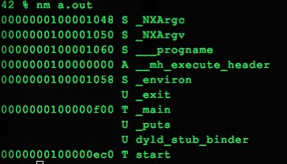
Compilation
#include <stdio.h>
#define HELLO "Hello World!\n" int main() {
printf(HELLO);
}
gcc -c hello.c
gcc -o a.out hello.o
./a.out
The last step links libraries, e.g. I/O, to create a stand alone executable binary
The compiler works in phases that transform the program into the executable one step at a time.

Slide 11
C Compilation Simplified Overview
foo.c
bar.c
C source files (text)
Compiler
Compiler/assembler combined here
Compiler
foo.o
bar.o
Machine code object files
Pre-built object file libraries
Linker
lib.o
a.out
Machine code executable file

Slide 12
Compilation: Advantages
Reasonable compilation time: enhancements in compilation procedure (Makefiles) allow only modified files to be recompiled

Slide 13
Compilation: Disadvantages
Compiled files, including the executable, are architecture-specific, depending on processor type (e.g., MIPS vs. x86 vs. RISC-V) and the operating system (e.g., Windows vs. Linux vs. MacOS)
Executable must be rebuilt on each new system
I.e., “porting your code” to a new architecture
“Change → Compile → Run [repeat]” iteration cycle can be slow during development
but make only rebuilds changed pieces, and can compile in parallel: make -j
linker is sequential though → Amdahl’s Law
Notes:
28:07

Slide 14
C Syntax

Slide 15
C Pre-Processor (CPP)
foo.c
CPP
foo.i
Compiler
C source files first pass through macro processor, CPP, before compiler sees code
CPP replaces comments with a single space
CPP commands begin with “#”
#include "file.h" /* Inserts file.h into output */
#include <stdio.h> /* Looks for file in standard location, but no actual difference! */
#define PI (3.14159) /* Define constant */
#if/#endif /* Conditionally include text */
Use –save-temps option to gcc to see result of preprocessing
Full documentation at: http://gcc.gnu.org/onlinedocs/cpp/
Notes:
show this on term

Slide 16
CPP Macros: A Warning...
You often see C preprocessor macros defined to create small "functions"
But they aren't actual functions, instead it just changes the text of the program
In fact, all #define does is string replacement
#define min(X,Y) ((X)<(Y)?(X):(Y))
🗹

Slide 17
Main
int main() { return 0;
}
C programs must have a main() function
main() called first when the program is started by the OS
main() returns an integer
without a return statement, undefined value is returned
The correct signature for main() is:
int main(int argc, const char* argv[]) { }

Slide 18
C Syntax: main
To get the main function to accept arguments, use this:
int main (int argc, char *argv[])
What does this mean?
argc will contain the number of strings on the command line (the executable counts as one, plus one for each argument). Here argc is 2:
unix% sort myFile
argv is a pointer to an array containing the arguments as strings (more on pointers later).
🗹

Slide 19
Getchar/printf
int c = 0;
while((c = getchar()) != EOF) printf("%c", c);
getchar() returns 1 character from “standard input” converted to an int
If the stream is at end-of-file or a read error occurs, EOF is returned
printf() outputs a string to the standard output
printf() takes a format string and a variable numbers of arguments that are converted to characters according to the requested format

Slide 20
Looping
int c = getchar(); while(c != EOF) {
printf("%c", c); c = getchar();
}
another way to express the same behavior
in C assignments are expressions, the same program without nesting

Slide 21
C Syntax: True or False?
What evaluates to FALSE in C?
0 (integer)
NULL (pointer: more on this later)
Boolean types provided by C99’s stdbool.h
What evaluates to TRUE in C?
…everything else…

Slide 22
C Data Types

Slide 23
Data Types
Data types are sets of values along with operations that manipulate them
For example, (signed) integers in C are made up of the set of values …, -1, 0, 1, 2, … along with operations such as addition, subtraction, multiplication, division…
Values must be mapped to data types provided by the hardware and operations compiled to sequences of hardware instructions

Slide 24
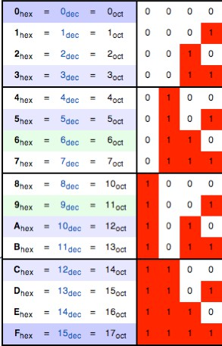
Byte
A byte = 8 bits
Decimal 0 to 255
Hexadecimal 00 to FF
Binary 00000000 to 11111111
In C:
Decimal constant:
Octal constant:
12
014
Hexadecimal constant: 0xC
http://en.wikipedia.org/wiki/Hexadecimal

Slide 25
Words
Hardware has a `Word size` used to hold integers and addresses
The size of address words defines the maximum amount of memory that can be manipulated by a program
Two common options:
32-bit words => can address 4GB of data
64-bit words => could address up to 1.8 x 10¹⁹
Different words sizes (integral number of bytes, multiples and fractions) are supported

Slide 26
Addresses
Addresses specify byte location in computer memory
address of first byte in word
address of following words differ by 4 (32-bit) and 8 (64-bit)
32-bit Words
64-bit Words
Bytes
Addr.
Addr = 0000
Addr = 0004
Addr = 0008
Addr = 0012
0000
0001
0002
0003
0004
0005
0006
0007
0008
0009
0010
0011
0012
0013
0014
0015
??
Addr
=
0000
??
??
??
Addr
=
0008
??
??
© ?@)-6 A+6@)* @)- B@C4 DEF@GG@+,)

Slide 27
Data Types
The base data type in C
int - used for integer numbers
float - used for floating point numbers
double - used for large floating point numbers
char - used for characters
void - used for functions without parameters or return value
enum - used for enumerations
The composite types are
pointers to other types
functions with arguments types and a return type
arrays of other types
structs with fields of other types
unions of several types

Slide 28
Qualifiers, Modifiers & Storage
Type specifiers
short - decrease storage size
long - increase storage size
signed - request signed representation
unsigned - request unsigned representation
Type qualifiers
volatile - value may change without being written to by the program
#define GPIO_PORT (*(volatile unsigned long*) 0x012345)
const - value not expected to change
Storage class
static - variable that are global to the program (that file only)
extern - variables that are declared in another file
register – variables that are stored in CPU registers (no address, just register number is assigned)

Slide 29
Sizes
Type | Range (32-bits) | Size in bytes
signed char | −128 to +127 | 1
unsigned char | 0 to +255 | 1
signed short int | −32768 to +32767 | 2
unsigned short int | 0 to +65535 | 2
signed int | −2147483648 to +2147483647 | 4
unsigned int | 0 to +4294967295 | 4
signed long int | −2147483648 to +2147483647 | 4 or 8
unsigned long int | 0 to +4294967295 | 4 or 8
signed long long int | −9223372036854775808 to +9223372036854775807 | 8
unsigned long long int | 0 to +18446744073709551615 | 8
float | 1×10⁻³⁷ to 1×10³⁷ | 4
double | 1×10⁻³⁰⁸ to 1×10³⁰⁸ | 8
long double | 1×10⁻³⁰⁸ to 1×10³⁰⁸ | 8, 12, or 16

Slide 30
Typed Variables in C
Must declare the type of data a variable will hold
Types can't change. E.g, int var = 2;
Type | Description | Example
Int uint32_t | Integer Numbers (including negatives) At least 16 bits, can be larger. uint32_t will always be 32 bits | 0, 78, -217, 0x7337
unsigned int | Unsigned Integers | 0, 6, 35102
float | Floating point decimal | 0.0, 3.14159, 6.02e23
double | Equal or higher precision floating point | 0.0, 3.14159, 6.02e23
char | Single character | ‘a’, ‘D’, ‘\n’
long | Longer int, Size >= sizeof(int), at least 32b | 0, 78, -217, 301720971
long long | Even longer int, size >= sizeof(long), at least 64b | 31705192721092512

Slide 31
Character representation
ASCII code (American Standard Code for Information Interchange): defines 128 character codes (from 0 to 127),
In addition to the 128 standard ASCII codes there are other 128 that are known as extended ASCII, and that are platform- dependent.
Examples:
The code for ‘A’ is 65
The code for ‘a’ is 97
The code for ‘b’ is 98
The code for ‘0’ is 48
The code for ‘1’ is 49

Slide 32
Get size of a type
Some data types are not interpreted the same on different platforms, they are machine-dependent
sizeof( x ) returns the size in bytes of the object x

Slide 33
Declarations
The declaration of a variable allocates storage for that variable and can initialize it
int lower = 3, upper = 5;
char c = ‘\\’, line[10], he[3] = “he”; float eps = 1.0e-5;
char arrdarr[10][10]; unsigned int x = 42; char* ardar[10]; char* a;
void* v;
void foo(const char[]);
Without an explicit initializer local variables may contain random values (static & extern are zero initialized)

Slide 34
Conversions
What is the meaning of an operation with operands of different types?
char c; int i; … i + c …
The compiler will attempt to convert data types without losing information; if not possible emit a warning and convert anyway
Conversions happen for operands, function arguments, return values and right-hand side of assignments.

Slide 35
Consts and Enums in C
Constant is assigned a typed value once in the declaration; value can't change during entire execution of program
const float golden_ratio = 1.618; const int days_in_week = 7; const double the_law = 2.99792458e8;
You can have a constant version of any of the standard C variable types
Enums: a group of related integer constants. E.g.,
enum cardsuit {CLUBS,DIAMONDS,HEARTS,SPADES};
enum color {RED, GREEN, BLUE};
An example program to demonstrate working of enum in C
#include<stdio.h>
enum week{Mon, Tue, Wed, Thur, Fri, Sat, Sun};
int main(){ enum week day; day = Wed; printf("%d",day); return 0;}
Output: 2

Slide 36
Union
Unions are used to
Compress bits of variables
Complete number of bits can be used by one variable at a time
union number {int a; char c;};
int main() {
union number num;
num.a = 10;
num.c = ‘c’;
return 0;
}
“a” will use all 4 bytes, while “c” will use only one byte
4 Bytes

Slide 37
Anonymous union
A union without a name
It can not be followed by an object
Not a type, an unnamed object
Variable names are unique in scope in which union is defined
void fn() {
union {int x, char c};
x=5;// union’s 4 bytes now store 5
// int x=10; uncomment to get error!
}

Slide 38
C Functions

Slide 39
Typed Functions in C
You have to declare the type of data you plan to return from a function
Return type can be any C variable type, and is placed to the left of the function name
You can also specify the return type as void
Just think of this as saying that no value will be returned
Also need to declare types for values passed into a function
Variables and functions MUST be declared before used
int number_of_people () { return 3; }
float dollars_and_cents () { return 10.33; }

Slide 40
Functions
Declaration defines the interface of a function; i.e., number and types of parameters, type of return value
A C prototype is an explicit declaration
int strl(char []);
First use of a function without a preceding prototype declaration implicitly declares the function
If prototype follows the first use => error
Definition gives the implementation of a function
int strl(char s[]) { int i = 0; while(s[i] != ‘\0’)
++i; //pre-increment,i++(post-increment)
return i; }

Slide 41
Return statement
return [(] [expression] [)];
Terminates the execution of a function and returns control to caller
Parenthesis are optional
Converted to declared return type
Return value can be ignored by caller

Slide 42
Return string from a function
char* AB(){
return “ncdc”;
}
int main(){
char* st =AB();
printf(“%s”,st);
}

Slide 43
Parameter passing
Historically programming languages have offered:
passed by value
passed by reference
passed by value-result
By-value semantics:
Copy of param on function entry, initialized to value passed by caller
Updates of param inside callee made only to copy
Caller’s value is not changed (updates to param not visible after return)

Slide 44
To swap or not to swap?
6
int y = 20, x = 10; swap(x,y);
void swap(int a, int b) { int t = a;
a = b;
b = t;
}
x
y
10
20
a
b
10
20

Slide 45
To swap!
int y = 20, x = 10; swap(&x,&y);
void swap(int* a, int* b) {
int t = *a;
*a = *b;
*b = t;
x
y
10
20
}
a
b

Slide 46
Recursive functions
A function can call itself
recursive expression of the function
requires a stopping condition
Example: n!
int fact(int n) { return (n<=1)
? 1 : n*fact(n-1);
//Conditional operator ?:
}

Slide 47
Assembler
Low-level language that maps directly to hardware
Perform arithmetic on registers or memory
Transfer data between memory and registers
Transfer control to procedures/returns or within a procedure

Slide 48
C Syntax : Control Flow (1/2)
A statement can be a {} of code or just a standalone statement
if-else
if (expression) statement
if (x == 0) y++;
if (x == 0) {y++;}
if (x == 0) {y++; j = j + y;}
if (expression) statement1 else statement2
There is an ambiguity in a series of if/else if/else if you don't use {}s, so use {}s to block the code
In fact, it is a bad C habit to not always have the statement in {}s, it has resulted in some amusing errors...
while
while (expression) statement
do statement while (expression);

Slide 49
C Syntax : Control Flow (2/2)
for
for (initialize; check; update) statement
initialize
for(;check;) {update}
C also has goto
But it can result in spectacularly bad code if you use it, so don't!

Slide 50
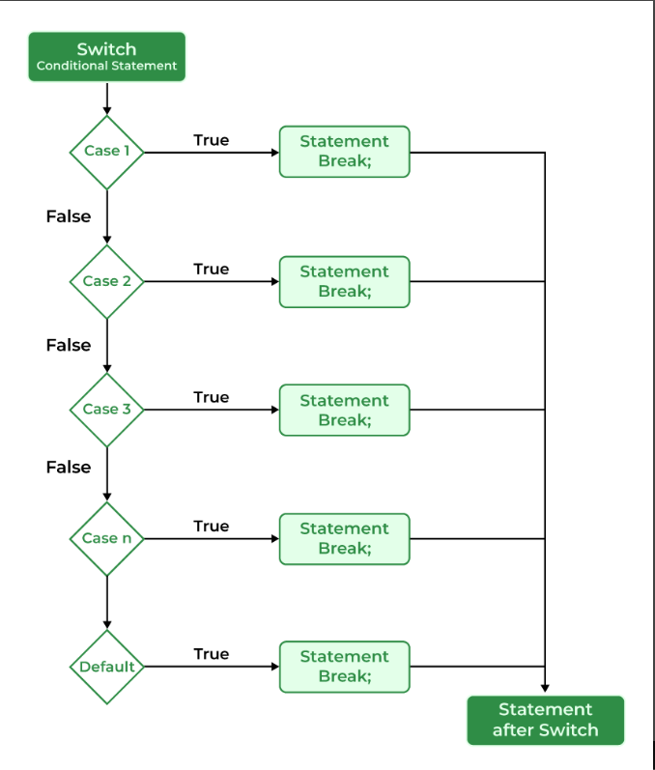
Control flow
Switch statement in C
One of the matching case if executed
If break is not provided all cases are checked
Switch variable can be of int or char type
#include <stdio.h>
int main() { // Switch variable int var = 1;
// Switch statement switch (var) {
case 1: printf("Case 1 is Matched.");
break;
case 2: printf("Case 2 is Matched.");
break;
case 3: printf("Case 3 is Matched.");
break;
default: printf("Default case is Matched.");
break; }
return 0;}

Slide 51
C Program Execution

Slide 52




...it’s all about the stack
The operating system creates a process by assigning memory and other resources
Stack
Stack: keeps track of the point to which each active subroutine should return control when it finishes executing; stores variables that are local to functions
Heap: dynamic memory for variables that are created with malloc, calloc, realloc and disposed of with free
Heap
Data
Data: initialized variables including global and static variables, un-initialized variables
Code
Code: the program instructions to be executed

Slide 53
Stack and heap
Heap is implemented as linked list
Memory fragmentation
Can result in memory allocation failure
Stack is implemented as LIFO
Stack frame of a function call
main
Code
Static storage
Params
Another function stack frame
Locals
Return Address
Static Link
Dynamic Link
Return Address

Slide 54
The Stack
Logically it’s a last-in-first-out (LIFO) structure
Two operations: push and pop
Grows ‘down’ from high-addresses to low
Holds “stack frames”, i.e. state of functions as they execute
top-most (lowest) frame corresponds to the currently executing function
Stores local variables and address of the function that needs to be executed next

Slide 55
C program execution
PC (program counter) points to next machine instruction to execute
Procedure call:
Prepare parameters
Save state (SP (stack pointer) and PC) and allocate on stack local variables
Jumps to the beginning of procedure being called
Procedure return:
Recover state (SP and PC (this is return address)) from stack and adjust stack
Execution continues from return address

Slide 56
First Big C Program: Compute Sines table
#include <stdio.h>
#include <math.h>
int main(void)
{
int angle_degree;
double angle_radian, pi, value;
printf("Compute a table of the sine function\n\n");
pi = 4.0*atan(1.0); /* could also just use pi = M_PI */
printf("Value of PI = %f \n\n", pi);
printf("Angle\tSine\n");
angle_degree = 0;/* initial angle value */
while (angle_degree <= 360) { /* loop til angle_degree > 360 */
angle_radian = pi * angle_degree / 180.0;
value = sin(angle_radian);
printf ("%3d\t%f\n ", angle_degree, value);
angle_degree += 10; /* increment the loop index */
}
return 0;
}
PI = 3.141593
Angle Sine
0 0.000000
10 0.173648
20 0.342020
30 0.500000
40 0.642788
50 0.766044
60 0.866025
70 0.939693
80 0.984808
90 1.000000
… etc …
🗹

Slide 57
C – File I/O

Slide 58
More General I/O
3
Redirection is done by the OS, not by C
But, C does provide a set of libraries for performing I/O
One such library:
stdio.h: provides operations to read (getchar and scanf) and write (putchar and printf) to stdin/stdout

Slide 59
stdio.h
4
printf: Provide a format string and arguments to print formatted text to the display
scanf: printf in reverse; you give it a format string that specifies the input to read followed by pointers. Ex:
scanf(“%s %d”, buffer, &int_var)
Reads in a string and an integer
Stores them in buffer and int_var respectively
getchar and putchar: get a single character from stdin or display a single character to stdout

Slide 60
stdio.h (cont.)
5
Also provides more general operations for dealing with files
A file is an abstraction of a non-volatile memory region:
Its contents remain after program execution
C exposes this file abstraction as a FILE*
You can only access files using interfaces provided by C

Slide 61
System Calls
7
System calls are services for interacting with the OS
C libraries let users invoke system calls through C functions System calls are slower than almost any other function Example:
I/O operations such as open, close, read, write
Memory allocation using malloc
- (more on this in future lectures)

Slide 62
File Manipulation
8
There are three basic actions when manipulating files:
Open
Read/Write
Close
When writing to a file, nothing is guaranteed to happen until it is closed

Slide 63
Opening a File Stream
13
FILE* fopen(const char* filename, const char* mode)
mode can be “r” (read), “w” (write), “a” (append).
Returns NULL on error. ALWAYS check for errors.
int fileno(FILE *stream) returns the fd associated with stream
// This code opens a file pointer in read mode char *mode = "r";
FILE* ifp = fopen("in.list", mode); if(ifp==NULL){printf("Failed");exit(1);}
FILE* ofp = fopen("out.list", "w");
if (ofp==NULL) {...}

Slide 64
Closing Files
14
You should ALWAYS close files before program termination For a file pointer: fclose(FILE *fp)
Why? Two reasons:
Output is buffered, closing enforces writing to disk
Leaving file pointers open may introduce security risks

Slide 65
And In Conclusion, …
C chosen to exploit underlying features of HW
Key C concepts
Pointers, arrays, implications for mem management
C compiled and linked to make executables
Pros (speed) and Cons (slow edit-compile cycle)
C looks mostly like Java except
no OOP, ADTs defined through structs
0 (and NULL) FALSE, all else TRUE (C99 bool types)
Use intN_t and uintN_t for portable code!
Unitialized variables contain garbage
“Bohrbugs” (repeatable) vs “Heisenbugs” (random)
🗹

Slide 66
Lab work
Introduction to gcc
Debugging in GDB

